Slide 1

Pixel Classification in Hyperspectral Images
BATCH NO: B13
P.VYSHNAVI (154G1A05A9) Project Guide:
P.PRATHIMA(154G1A0564) Dr.T.Hitendra Sarma M.Tech., Ph.D.
J.TEJASWI(154G1A0598) Associate Professor
G.RAHUL (154G1A0567)
V.
Srinivasa Ramanujan Institute of Technology
Department of Computer Science & Engineering

Slide 2
Contents
Introduction
Abstract
Brief on Hyperspectral images
Procedure
Process flow
Requirements
Classification of leaf signatures
References

Slide 3
Introduction
Agriculture is the backbone of our Indian economy.
Agriculture not only provides food and raw material but also employment oppurtunities.
The major issue in agriculture is, once leaves are infected, they become stunted.
Since there are no signiﬁcant scars on the infected leaves, it is hard to judge this disease by human eyes, especially in the early stage.
In recent years, various imaging technologies have been applied to detect plant diseases or healthy conditions.
To minimize the losses and maximize yields Hyperspectral Imaging Technique is used.

Slide 4
Abstract
Hyperspectral image contains reflectance information across more bands of the electromagnetic spectrum. Disease detection plays an important role in agriculture field. Techniques to identify the affected crop area have great importance.
Dimensionality reduction is the process of reducing the number of pixels under consideration.
This Hyperspectral Image Analysis has been widely applied in plant disease classification. Pixel classification in hyperspectral image is used for automatic detection of leaf diseases.

Slide 5
Brief on Hyper spectral Images:
A Hyper spectral imaging is to obtain the spectrum for each pixel in the image of a scene, with the purpose of finding objects, identifying materials, or detecting processes.
The human eyes see color of visible light in mostly three bands (red,green,blue)spectral imaging divides the spectrum in to many more bands.
This technique of dividing images into bands can be extended beyond the visible. In hyperspectral imaging, the recorded spectra have fine wavelength resolution and cover a wide range of wavelengths.
Hyperspectral imaging measures continuous spectral bands, as opposed to multispectral imaging which measures finite spectral bands.

Slide 6
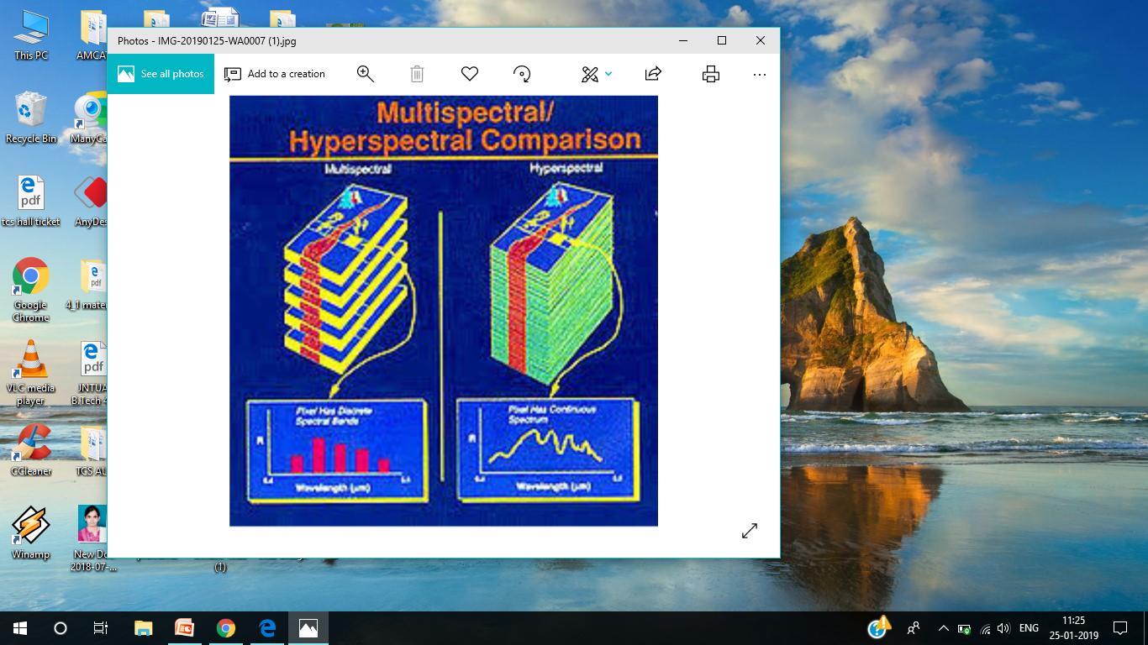
Continued..

Slide 7
Procedure
Collecting the Datasets where this datasets contains the signatures of the leaves.
Consider the Samples.
Classification is done for that Samples by using KNN algorithm.
Reducing the dimensions of the pixels by using PCA.
Comparing the Sample dataset signatures.

Slide 8
Process flow
Feature Extraction
Input Image
Classification
Predicted class of disease
Assess the Classification Accuracy

Slide 9
Requirements
Software Requirements:
MATLab.
Hardware Requirements:
Operating System-:Windows 7 or above.
RAM :4-GB required.
Disk Space :2-GB for MATLab.
4-6 GB for typical Installation.
Spectrometer.

Slide 10
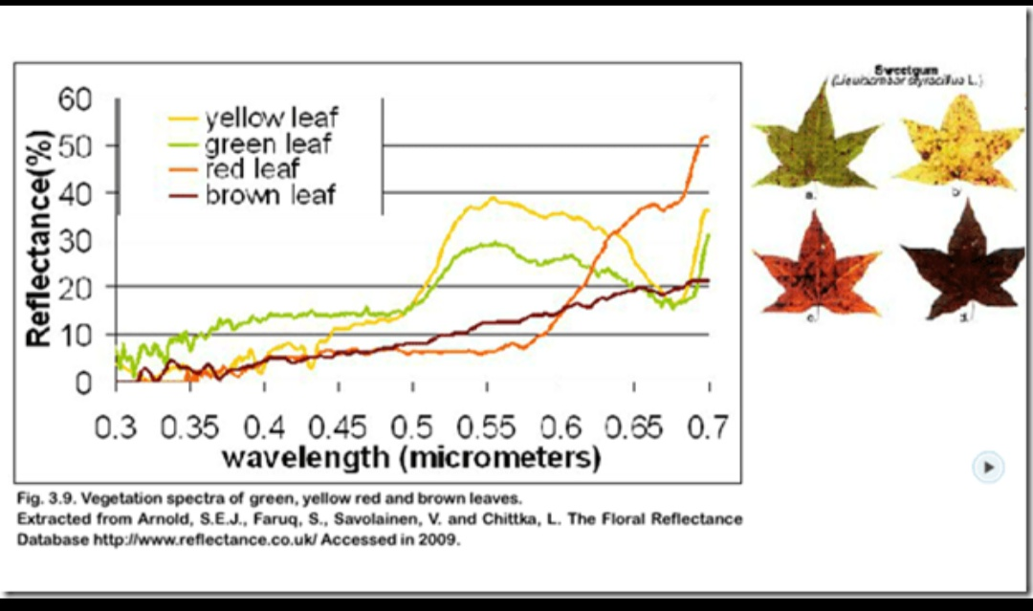
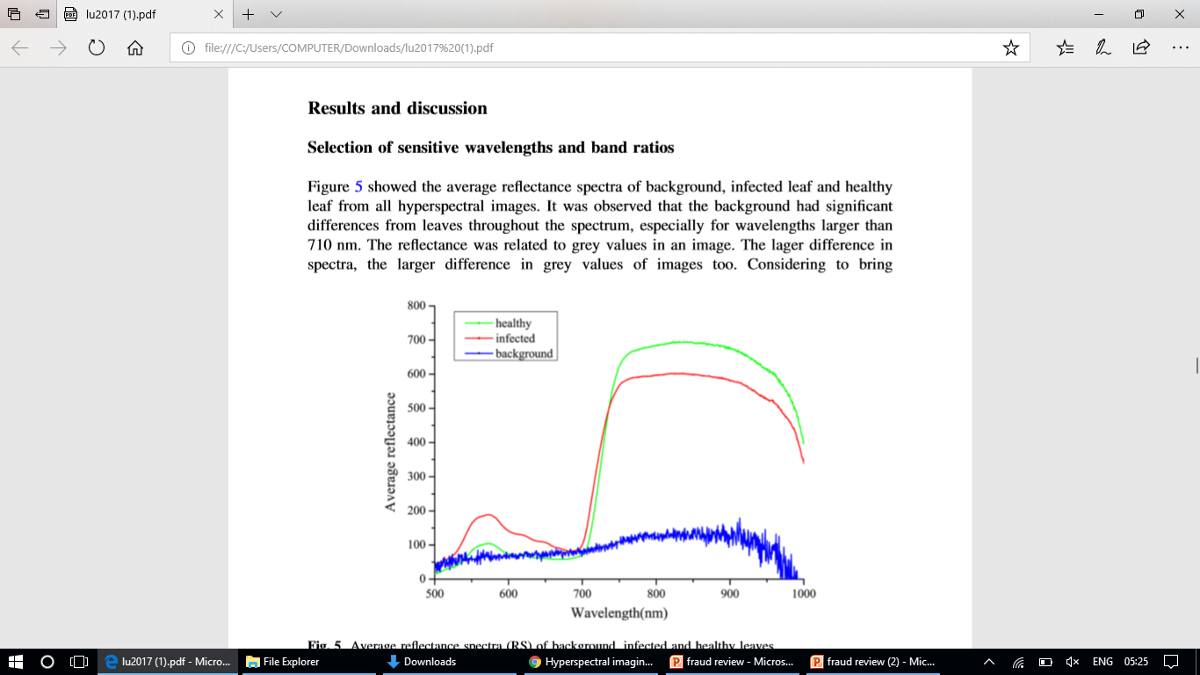
Classification of leaf Signatures

Slide 11
References:
Prakash,R.Meena,et al.”Detection of leaf diseases and classification using digital image processing”,Innovations in Information,Embedded and Communication Systems(ICIIECS),2017 International Conference on.IEEE,2017.

Slide 12
Thank you
Queries
?

